Slide 1
CISTECH, Inc The XA Experts March 2, 2010
STREAMLINED PROCURE TO PAY (P2P) PROCESSING FOR XA
Denise Luther
Senior Technical Consultant
CISTECH, Inc.
Denise.luther@cistech.net
David Kemp
Senior Business Consultant
CISTECH, Inc.
David.kemp@cistech.net
Ben McCormick
General Manager
CISTECH, Inc.
Ben.mccormick@cistech.net

Slide 2
Why focus on P2P?
Streamline supply chain
Shorten Material Lead Times
Right stuff, right place, right time
Minimize expediting costs
Improve cash flow, take advantage of terms
Reduce Inventories
Improve Efficiencies
Less labor to create purchasing paperwork, negotiate, process receipt, pay invoices, etc.

Slide 3
CISTECH Procure to Pay (P2P)
PURCHASING
RECEIVING
FINANCE
Requisition via eReq
PO Auto Release
Confirmation/ Vendor Communication via Supplier Portal
Receipt via Scanned Barcode using RF Inventory Txn
IFM Invoice On Receipt Capabilities
Payment via EFT

Slide 4
Internal Processing / eReq for XA
CISTECH’s eREQ for XA streamlines the procurement approval process by providing managers with real-time requisition notification and electronic approvals
Benefits
Improves the timeliness, accuracy, and efficiency of communications between requesters, buyers and managers, which results in:
Shorter cycle time in requisition approval process
Reduced paperwork and administration costs
Improved visibility of Requisition/PO approval status
Decreased expediting costs due to delays in approvals
Improved uptime through visibility of direct material and/or machine part approvals

Slide 5
eReq for XA
PowerLink enabled
e-Mail enabled

Slide 6
CISTECH Procure to Pay (P2P)
PURCHASING
RECEIVING
FINANCE
Requisition via eReq
PO Auto Release
Confirmation/ Vendor Communication via Supplier Portal
Receipt via Scanned Barcode using RF Inventory Txn
IFM Invoice On Receipt Capabilities
Payment via EFT

Slide 7
Vendor Communications / Supplier Portal for XA
CISTECH’s Supplier Portal extends XA procurement capabilities with a web portal for vendors
Benefits
Improves the timeliness, accuracy, and efficiency of communications between buyers and suppliers, resulting in:
increased inventory turns by reducing the ‘slack’ in your supply chain
improved on time deliveries and fewer shortages on the production line
reduction in expediting costs
improved quality compliance
improved productivity of purchasing and receiving staff
improved quality of information available to suppliers creates opportunities to reduce cost of purchased items

Slide 8
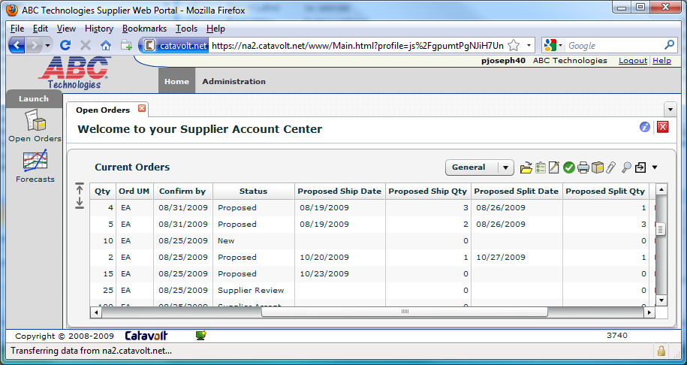
Supplier Portal for XA

Slide 9
CISTECH Procure to Pay (P2P)
PURCHASING
RECEIVING
FINANCE
Requisition via eReq
PO Auto Release
Confirmation/ Vendor Communication via Supplier Portal
Receipt via Scanned Barcode using RF Inventory Txn
IFM Invoice On Receipt Capabilities
Payment via EFT

Slide 10
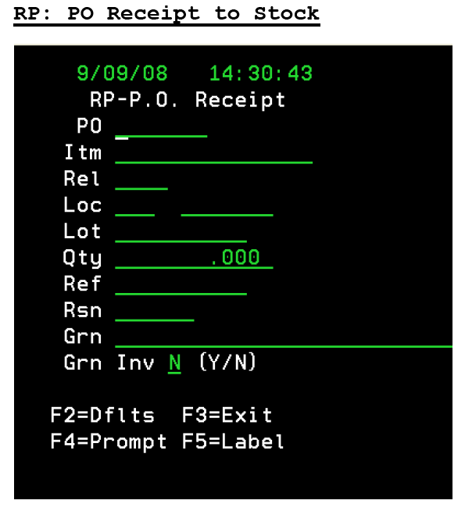
Receipt of Goods – CISTECH RF Transactions
Barcoded material arrives at dock (barcode applied by supplier via Supplier Portal)
Materials handler can simply scan barcodes using RF unit to receive to dock / stock

Slide 11
CISTECH Procure to Pay (P2P)
PURCHASING
RECEIVING
FINANCE
Requisition via eReq
PO Auto Release
Confirmation/ Vendor Communication via Supplier Portal
Receipt via Scanned Barcode using RF Inventory Txn
IFM Invoice On Receipt Capabilities
Payment via EFT

Slide 12
Approve Payment / IFM Invoice on Receipt
IFM’s “Invoice on Receipt” can be implemented by supplier.
Requires a unique shipment number (GRN) and the PO number – both are automatically provided by the supplier portal “Shipment Notification” transaction.
You can automatically voucher payment based on shipment received from a supplier
process uses PO price, so there are no price discrepancies
schedules payment based on vendor terms, with an invoice date = receipt date

Slide 13
Payment Vouchers / Invoice on Receipt
Process is much quicker than traditional 3 way match. It eliminates the accrual process required for receipts not invoiced. You don’t have to wait for the invoice, or have to reconcile discrepancies in price or qty in the invoice.

Slide 14
CISTECH Procure to Pay (P2P)
PURCHASING
RECEIVING
FINANCE
Requisition via eReq
PO Auto Release
Confirmation/ Vendor Communication via Supplier Portal
Receipt via Scanned Barcode using RF Inventory Txn
IFM Invoice On Receipt Capabilities
Payment via EFT

Slide 15
Electronic Funds Transfer (EFT/ACH)
Streamlines AP processing through electronic funds transfers for foreign or domestic vendor payment
Application Benefits
Relieves the accounting department of the time consuming task of manual payment processing
Provides a faster, more reliable payment method for vendors
Eliminate the need for pre-printed or electronic check forms
Eliminate mailing costs for AP checks and remittance detail

Slide 16
Electronic Funds Transfer (EFT/ACH)
Generates ACH Bank file
Validation performed to ensure required data
Error report provided
Inquiry available for details
Transfers Bank file to IFS drive for transmission to bank
File is available for e-mail or further processing for automated communication to the bank

Slide 17
Demonstration
Denise Luther
CISTECH eReq
David Kemp
CISTECH Supplier Portal

Slide 18
CISTECH Procure to Pay (P2P)
PURCHASING
RECEIVING
FINANCE
Requisition via eReq
PO Auto Release
Confirmation/ Vendor Communication via Supplier Portal
Receipt via Scanned Barcode using RF Inventory Txn
IFM Invoice On Receipt Capabilities
Payment via EFT

Slide 19
THANK YOU!
Ben McCormick
704-814-0016
Ben.mccormick@cistech.net

