Slide 1
CISTECH
Supplier Portal for eKanban Users

Slide 2
Agenda
eKanban-Opportunities to improve supply chain performance
Supplier Portal Overview
Demo for eKanban procurement
Benefits
Deployment and Summary

Slide 3
eKanban Users-Opportunities for
Supply Chain improvement
Improve visibility of exception items
  Know quickly if supplier cannot fulfill requirements, develop alternatives
Improve visibility of shipment information
  Focus expediting efforts on critical items
  Reschedule shop if necessary
Improve receiving efficiency
  Visibility of inbound items
  Receipt by shipping notifications
  Receiving and put away using bar-coded Kanban cards

Slide 4
Supplier Portal Overview
For the buyer and users…
Prompt, two-way communication
Instant visibility of supplier commitments
Instant visibility of shipments
All integrated into Power-Link
For the supplier…
Link from existing eKanban email provides detailed order information
Online access to real time order list and forecasts
One-click acknowledgment
Easy notification of shipment

Slide 5


Simple scenario
Buyer
eKanban e-mail initiates order
See Supplier Accept
Supplier
View Orders
Accept (VA)

Slide 6
Change scenario
Buyer
eKanban Order
Review change
Accept change
See Supplier Accept
Supplier
View Orders
Propose change
See Customer Accept
Accept (VA)

Slide 7
The roles
Buyer
(Power-Link)
Shipping
Supervisor
(Portal)
Customer
Supplier

Slide 8
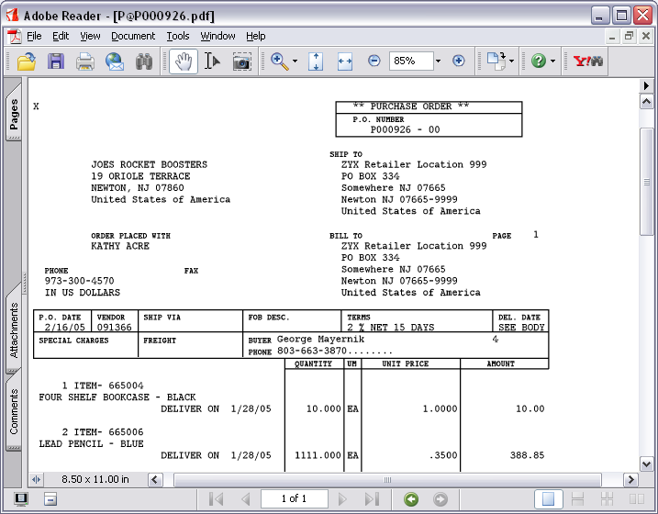

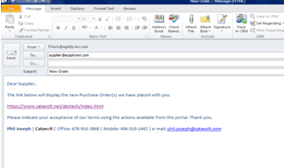
eKanban: empty bin scan
Purchase
Order
e-mail
with
link

Slide 9
Demonstration

Slide 10
What we saw…
Proactive notification via eKanban e-mail
Confirmation of receipt and delivery, or…
Proposed change of date or quantity
Shipment notices provide visibility of scheduled receipts
Expedited receiving with shipment notices and bar coded Kanban labels
Forecast: Annual view of open and planned orders

Slide 11
What we didn’t see…
Supplier Portal for non-eKanban procurement
Requisition workflow
Notification of PO through e-mail or portal
Extended ‘negotiation’ of date and quantity
2-way attachments and notes log
Expedited receiving with shipment notices or bar coded item labels
Automatically create backordered items with updated shipment dates

Slide 12
Questions?

Slide 13
Benefits Summary
Improved visibility gives you the confidence to reduce muda in your supply chain
  Lower inventories
  Improved efficiency of staff
Improved visibility helps reduce schedule changes and downtime caused by stock outs
Better communications reduces expediting costs
Better communications ensures products meet quality and design specs, reducing cost of quality

Slide 14
Deployment:
Supplier
iSeries
XA R7
Enterprise Integrator
System Link
Supplier
Catavolt Server
Data Source
One XA User
Many Portal users
Supplier
Supplier
Buyer:Power
Link
Supplier
Supplier
Supplier Portal

Slide 15
Supplier Portal Technology:
Extension of XA
Power-Link (Procurement Mgmt) for Buyers and Internal Users
Enterprise Integrator and System-Link for IT
Achieve Benefits Quickly!
  Fast start-up
  Minimal training
  Low maintenance
    Uses core XA data…no external database

Slide 16
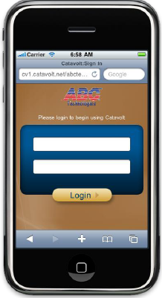
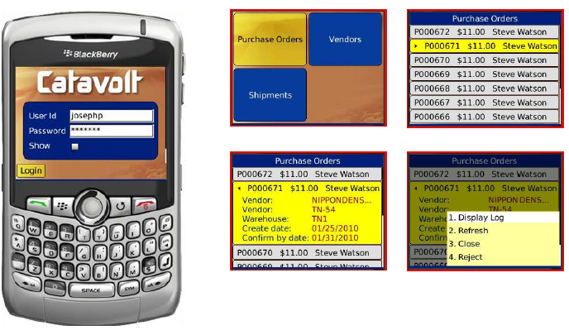
Catavolt XA Extender Technology

Slide 17
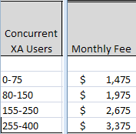
Quick ROI
Test supplier up and running in less than 2 weeks
Implementation services < 10 days
Low monthly fee, includes support and upgrades:
30 day cancellation notice-no risk!

Slide 18
Q&A
Frank Geric fgeric@agility-inc.com
440-546-9290
Mike Taylor mike.taylor@cistech.net
423-822-6499

Slide 19
Additional Information

Slide 20
Pro-active notification
eKanban initiates the PO
Issue a release
Change a PO quantity or date
Automatic text message
  Order placed, check e-mail
Automatic e-mail
  Link provides one-click access to portal
e-mail
text
message
Buyer
Supplier

Slide 21


Supplier can see your requirements
Orders placed by their customer
  Items, quantities and dates
Both item numbers: customer’s and their own
Confirm by date
Forecast: Annual view of open and planned orders
Forecast

Slide 22
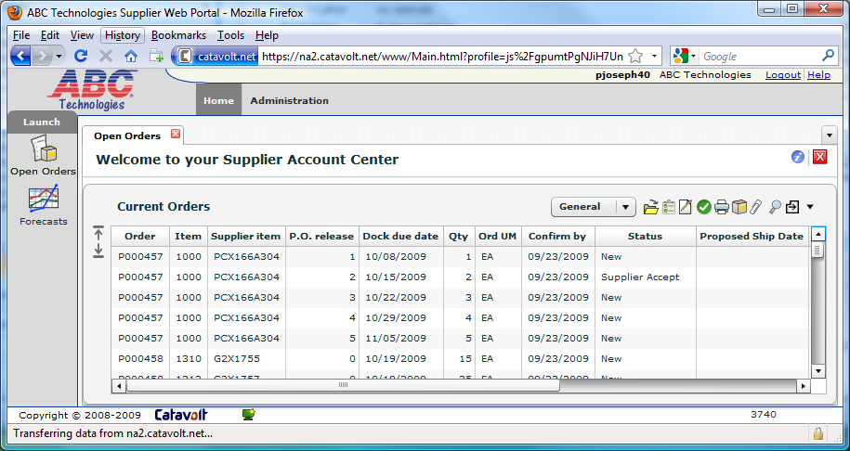
Supplier View
Orders initiated by eKanban or via Procurement Management
Suppliers can see both your item and their internal item number
Confirm delivery per line item by date
Supplier gets an e-mail each time a PO line item or release is created

Slide 23
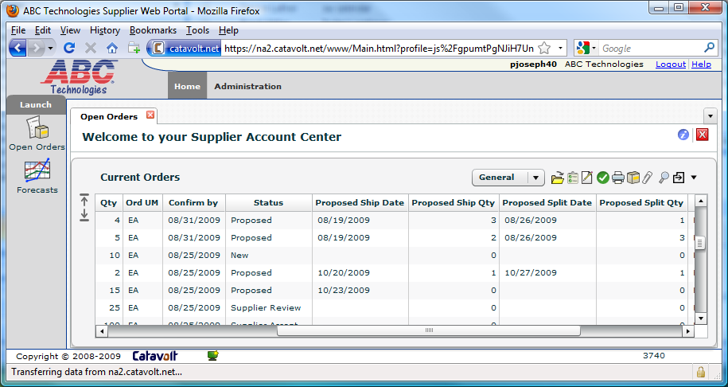
Supplier Response
Status
Proposed…
  Ship date
  Ship quantity
  Split date
  Split quantity

Slide 24
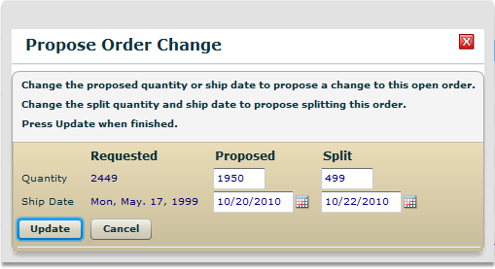
Supplier Response
Same quantity, different date
Partial quantity on requested date
Split shipment

Slide 25
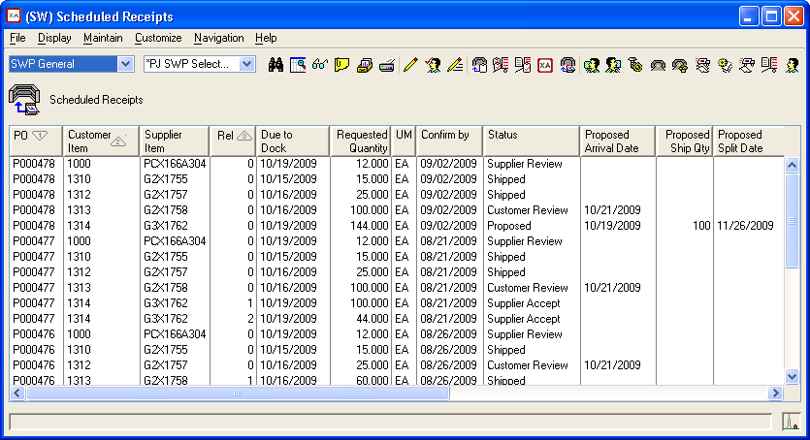
Buyer’s Power-Link View
Same as the Portal
Can be the same view
…or a similar one
  Add Vendor
  Remove Vendor Catalog
See supplier commitments and proposals

Slide 26
Buyer can see…
Orders under review by Supplier
Orders accepted or not accepted
Changes proposed by Supplier
Supplier’s comments
Suppliers attachments
You have clear understanding of their commitments; no confusion in the hand-off

Slide 27
Real Time Feedback
Supplier actions show up in Power-Link
Buyer can take action as required
Supplier
Review or Accept
Propose change
Buyer
No action required
Review, Accept or Reject

Slide 28

Shipping
Supplier
Receiving
Print labels
Upload attachments
Send shipment notice
Export
Decl
Certificate
of Origin
Packing List
Receive goods via Materials Management

Slide 29
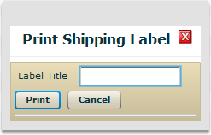
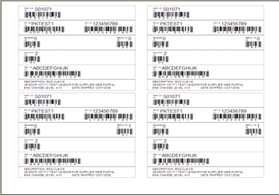
Item labels
Bar coded kanban cards with Item and PO
  Used for receiving and inventory transactions
Supplier can print as many
as they need on their local
printer

Slide 30
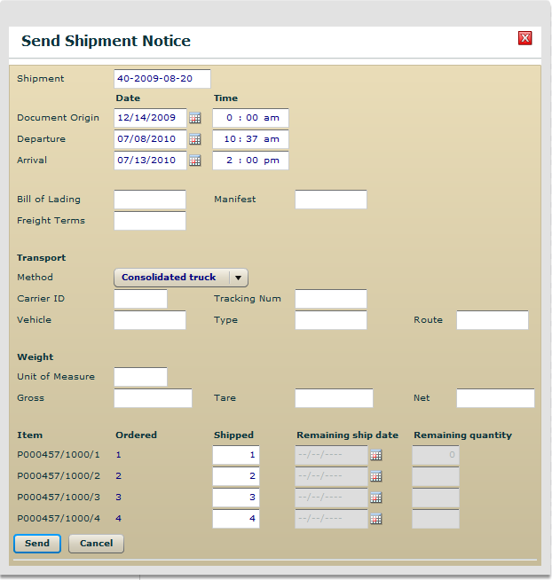
Send shipment notice
Select multiple lines
Fill in quantity shipped per line
If short, add date for rest
  Same as proposing a split quantity
Creates Shipment Notice in Power-Link

Slide 31
‘Traditional’ Procurement-Additional Opportunities for improvement
Integrated Requisition Approval
Streamline more extensive ‘conversation’
  Controlled negotiation to confirm delivery and quantity requirements
Share information on specs, quality
  View comments
  Download drawings, specification documents, etc.
Improved Visibility allows you to address critical exceptions

Slide 32
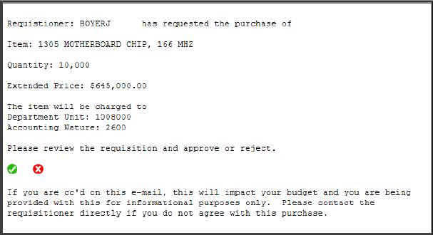
Electronic Requisition Approval
Hierarchy based on user
Can be addressed directly from email

Slide 33
Streamline the ‘negotiation’
Same quantity, different date
Partial quantity on requested date
Split shipment

Slide 34
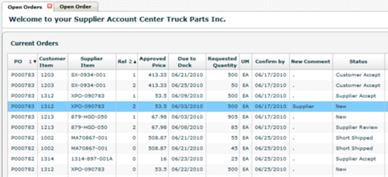
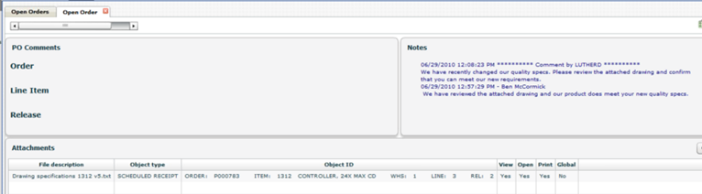
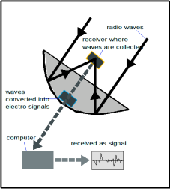
Improved Communications with comments and attachments
‘Conversation’ log
PO
Comments
Supplier can also create attachments, ie shipping documents, import papers…

Slide 35
Portal Design
Leveraging the Infor Development Framework

Slide 36
Leveraging the Infor Development Framework
Power-Link – for the Buyer
  Views – General, Shipping and Export
  Deployment Profiles
System-Link – for IT
  Retrieve data for Portal
  Update XA from Portal
  Two-way attachments
Enterprise Integrator – for IT
  Primary objects (Forecast)
  Secondary objects (Scheduled Receipt Extension)
  User Exit programs (Split shipment)
  Transaction programs (Label print)
  Publish & Subscribe (Alerts to suppliers)

Slide 37
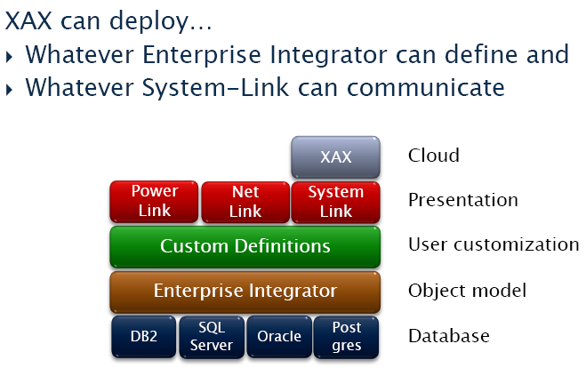
XA Extender ‘extends’ the IDF

Slide 38
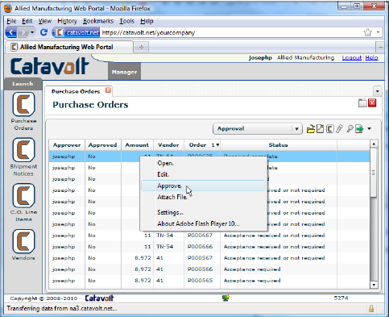
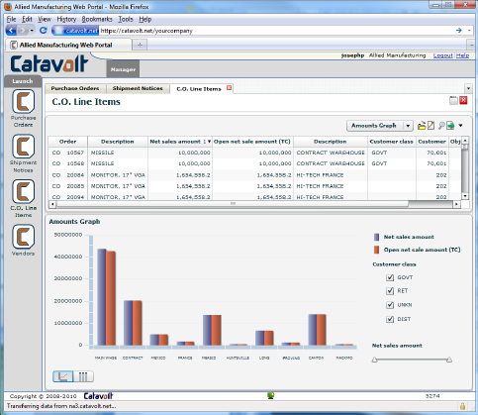
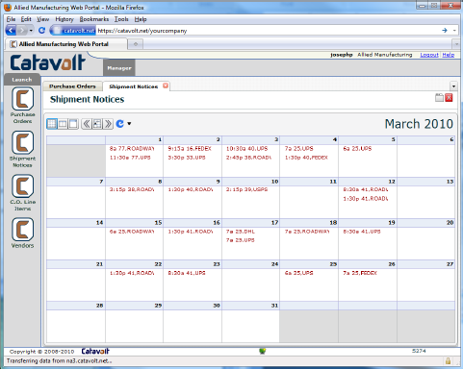
Leverage Integrator to deploy to the web

Slide 39
Technology summary
Built for XA
Built for the web
Gives you what you want
  All the good things
    Availability, performance, productivity…
  None of the bad things
    Moving parts, new things to manage…
If you like the Infor Development Framework, this is the way to go

